Slide 1
Group 6
Presentation 2

Slide 2
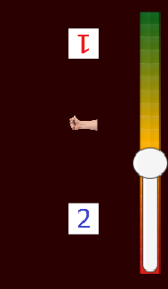
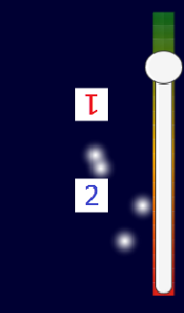
What is our Game?
Brief synopsis of game genre, theme etc…
Timing mechanic
First turn
Time, Tap, Progress

Slide 3
What does the player do?
*Brief synopsis of what each player does within the game and how they interact with each other; core game loop (this can be inserted from previous presentation)*
1
2
3
4
5

Slide 4
Latest Prototype

Slide 5
Latest Prototype

Slide 6
Theme
*Explain what our theme is and backup thematic decisions. Refer to work carried out in “Justification for Game Theme” document found in Research\Game Development Research\ Thematics*

Slide 7
Concept Art
*Insert various samples of concept art for both the player character (i.e. the ducks themselves), as well as various arms*

Slide 8
The Importance of Playtesting
*Playtesting Feedback and how iterative cycle impacted latest build (could also make connections to demographics?)*

Slide 9
Where’s the fun?
*Describe how game mechanics/theme relate to appropriate theory on fun; 4 keys 2 fun etc…*

Slide 10
Features of Game
*Brief synopsis of all game’s current features and any currently planned for later builds (may link back to feedback/iterative cycle slide). As requested by Rob’s email*

Slide 11
Questions?

Slide 12
*TEMPORARY SLIDE* - Only purpose is to imbed custom colour scheme for later edits

